Slide 1



Strength and Growth
Sales Performance Analysis of Walmart Stores
Using Advanced MySQL Techniques
Presented by - Mukesh Patil

Slide 2


Introduction
Walmart, a major retail chain, operates across several cities, offering a wide range of products.
The dataset provided contains detailed transaction data, including customer demographics, product lines, sales figures, and payment methods.
This project will use advanced SQL techniques to uncover actionable insights into sales performance, customer behavior, and operational efficiencies.
Objective
Key areas of analysis include:
Identifying top-performing branches and products
Understanding customer spending behavior
Detecting anomalies in sales transactions
Evaluating payment method preferences and sales trends
Identifying repeat customers and rewarding high-value customers

Slide 3

Dataset Description
The dataset contains sales transactions with columns like:
Branch: The store location where the sale occurred
Product Line: Categories of products sold (e.g., Electronics, Fashion)
Total: The total sales amount for each transaction
COGS: Cost of Goods Sold, to calculate profit
Customer Type: Indicates whether the customer is a Member or Normal
Payment: Mode of payment (Credit Card, E-wallet, etc.)

Slide 4
Task 1: Identifying the Top Branch by Sales Growth Rate
WITH SalesByPeriod AS (
SELECT
Branch,
DATE_TRUNC('month', SaleDate) AS SaleMonth,
SUM(Total) AS TotalSales
FROM
WalmartSalesData
GROUP BY
Branch, DATE_TRUNC('month', SaleDate)
),
SalesGrowth AS (
SELECT
Branch,
SaleMonth,
TotalSales,
LAG(TotalSales) OVER (PARTITION BY Branch ORDER BY SaleMonth) AS PreviousMonthSales
FROM
SalesByPeriod
),
GrowthRates AS (
SELECT
Branch,
SaleMonth,
TotalSales,
(TotalSales - PreviousMonthSales) / PreviousMonthSales * 100 AS SalesGrowthRate
FROM
SalesGrowth
WHERE
PreviousMonthSales IS NOT NULL
)
SELECT
Branch,
MAX(SalesGrowthRate) AS MaxGrowthRate
FROM
GrowthRates
GROUP BY
Branch
ORDER BY
MaxGrowthRate DESC
LIMIT 1;
Branch | Max Growth Rate
A | 26.1183

Slide 5
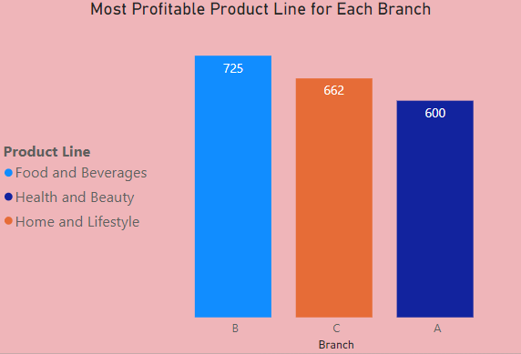
Task 2: Finding the Most Profitable Product Line for Each Branch
WITH ProfitData AS (
SELECT
Branch,
ProductLine,
SUM(GrossIncome) AS Profit,
ROW_NUMBER() OVER (PARTITION BY Branch ORDER BY SUM(GrossIncome - COGS) DESC) AS rn
FROM
WalmartSalesData
GROUP BY
Branch, ProductLine
)
SELECT
Branch,
ProductLine,
Profit
FROM
ProfitData
WHERE rn = 1;

Slide 6
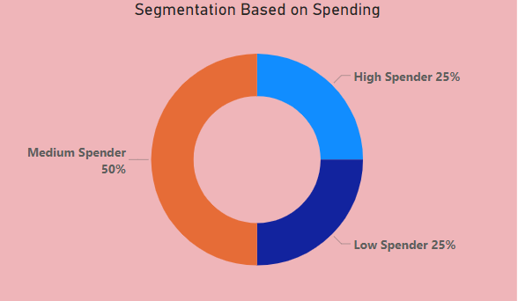
Task 3: Analyzing Customer Segmentation Based on Spending
WITH CustomerSpending AS (
SELECT
InvoiceID,
SUM(Total) AS TotalSpending
FROM
WalmartSalesData
GROUP BY
InvoiceID
),
SpendingPercentile AS (
SELECT
InvoiceID,
TotalSpending,
NTILE(4) OVER (ORDER BY TotalSpending DESC) AS SpendingTier
FROM
CustomerSpending
)
SELECT
InvoiceID,
TotalSpending,
CASE
WHEN SpendingTier = 1 THEN 'High Spender'
WHEN SpendingTier = 2 OR SpendingTier = 3 THEN 'Medium Spender'
ELSE 'Low Spender'
END AS CustomerTier
FROM
SpendingPercentile;
Customer Tier | Count of InvoiceID
Higher Spender | 250
Medium Spender | 500
Lower Spender | 250

Slide 7
Task 4: Detecting Anomalies in Sales Transactions
FROM
WalmartSalesData w
JOIN
ProductLineStats p
ON
w.ProductLine = p.ProductLine
)
SELECT
InvoiceID,
Branch,
ProductLine,
Total,
ZScore
FROM
SalesWithZScore
WHERE
ABS(ZScore) > 3;
WITH ProductLineStats AS (
SELECT
ProductLine,
AVG(Total) AS AvgTotal,
STDDEV(Total) AS StdDevTotal
FROM
WalmartSalesData
GROUP BY
ProductLine
),
SalesWithZScore AS (
SELECT
w.InvoiceID,
w.Branch,
w.ProductLine,
w.Total,
p.AvgTotal,
p.StdDevTotal,
(w.Total - p.AvgTotal) / p.StdDevTotal AS ZScore (w.Total - p.AvgTotal) / p.StdDevTotal AS ZScoreceID,
invoiceid | branch | total | zscore
687-47-8271 | A | 1039.29 | 3.014398
860-79-0874 | C | 1042.65 | 3.028193

Slide 8
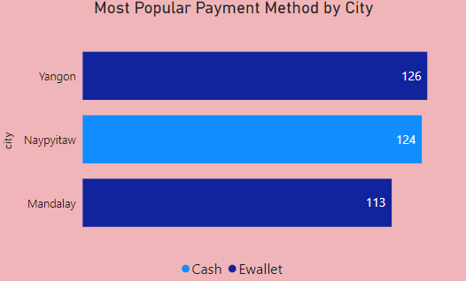
Task 5: Most Popular Payment Method by City
city | mostpopularpaymentmethod | paymentcount
Mandalay | Ewallet | 113
Naypyitaw | Cash | 124
Yangon | Ewallet | 126
SELECT
City,
Payment AS MostPopularPaymentMethod,
PaymentCount
FROM
RankedPayments
WHERE
rn = 1;
WITH PaymentCounts AS (
SELECT
City,
Payment,
COUNT(*) AS PaymentCount
FROM
WalmartSalesData
GROUP BY
City, Payment
),
RankedPayments AS (
SELECT
City,
Payment,
PaymentCount,
ROW_NUMBER() OVER (PARTITION BY City ORDER BY PaymentCount DESC) AS rn
FROM
PaymentCounts
)

Slide 9
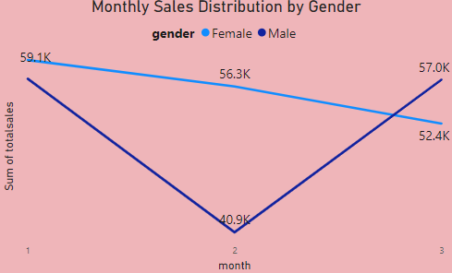
Task 6: Monthly Sales Distribution by Gender
SELECT
EXTRACT(YEAR FROM SaleDate) AS Year,
EXTRACT(MONTH FROM SaleDate) AS Month,
Gender,
SUM(Total) AS TotalSales
FROM
WalmartSalesData
GROUP BY
EXTRACT(YEAR FROM SaleDate),
EXTRACT(MONTH FROM SaleDate),
Gender
ORDER BY
Year, Month, Gender;
year | month | gender | totalsales
2019 | 1 | Female | 59139.15
2019 | 1 | Male | 57152.96
2019 | 2 | Female | 56335.65
2019 | 2 | Male | 40883.93
2019 | 3 | Female | 52408.46
2019 | 3 | Male | 57047.28

Slide 10
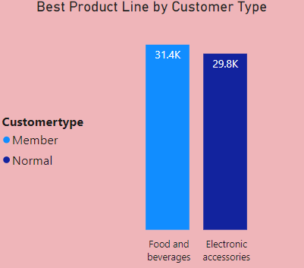
Task 7: Best Product Line by Customer Type
customertype | bestproductline | totalsales
Member | Food and beverages | 31357.71
Normal | Electronic accessories | 29839.1
WITH ProductLineSales AS (
SELECT
CustomerType,
ProductLine,
SUM(Total) AS TotalSales
FROM
WalmartSalesData
GROUP BY
CustomerType, ProductLine
),
RankedProductLines AS (
SELECT
CustomerType,
ProductLine,
TotalSales,
ROW_NUMBER() OVER (PARTITION BY CustomerType ORDER BY TotalSales DESC) AS rn
FROM
ProductLineSales
)
SELECT
CustomerType,
ProductLine AS BestProductLine,
TotalSales
FROM
RankedProductLines
WHERE
rn = 1;

Slide 11
Task 8: Identifying Repeat Customers
WITH CustomerPurchases AS (
SELECT
InvoiceID,
SaleDate,
ROW_NUMBER() OVER (PARTITION BY InvoiceID ORDER BY SaleDate) AS PurchaseOrder
FROM
WalmartSalesData
),
RepeatCustomers AS (
SELECT
c1.InvoiceID,
c1.SaleDate AS FirstPurchaseDate,
c2.SaleDate AS NextPurchaseDate,
(c2.SaleDate - c1.SaleDate) AS DaysBetweenPurchases
FROM
CustomerPurchases c1
JOIN
CustomerPurchases c2
ON
c1.InvoiceID = c2.InvoiceID
AND c2.PurchaseOrder = c1.PurchaseOrder + 1
)
SELECT
InvoiceID,
FirstPurchaseDate,
NextPurchaseDate,
DaysBetweenPurchases
FROM
RepeatCustomers
WHERE
DaysBetweenPurchases <= 30;
No Reapeat Customer
for this Dataset

Slide 12
Task 9: Finding Top 5 Customers by Sales Volume
WITH CustomerSales AS (
SELECT
InvoiceID,
SUM(Total) AS TotalSales
FROM
WalmartSalesData
GROUP BY
InvoiceID
)
SELECT
InvoiceID,
TotalSales
FROM
CustomerSales
ORDER BY
TotalSales DESC
LIMIT 5;
invoiceid | totalsales
860-79-0874 | 1042.65
687-47-8271 | 1039.29
283-26-5248 | 1034.46
751-41-9720 | 1023.75
303-96-2227 | 1022.49

Slide 13
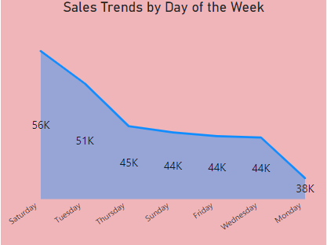
Task 10: Analyzing Sales Trends by Day of the Week
SELECT
TO_CHAR(SaleDate, 'Day') AS DayOfWeek,
SUM(Total) AS TotalSales
FROM
WalmartSalesData
GROUP BY
DayOfWeek
ORDER BY
TotalSales DESC;

Slide 14

Key takeways
Key findings include the identification of the top branch by sales growth rate, which highlights areas of strong performance. Additionally, the analysis pinpoints the most profitable product lines for each branch, allowing for targeted marketing strategies.
Customer segmentation based on spending habits provides a clearer understanding of different customer types, enabling tailored approaches to enhance engagement. Furthermore, the detection of anomalies in sales transactions ensures that any irregularities are addressed promptly, maintaining the integrity of sales data.
The exploration of payment methods across various cities also sheds light on consumer preferences, which can inform future operational decisions. Overall, the comprehensive analysis not only enhances performance metrics but also supports strategic planning for Walmart's continued success.

Slide 15
Sales Performance Analysis of Walmart Stores
Thank you very much!

